Slide 1








Speech to Speech Web-Based Spelling App using Agent to Agent approach from Grade 1 - 6
by Marc Sandrino
Predictive Systems Inc

Slide 2



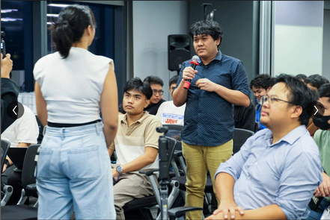
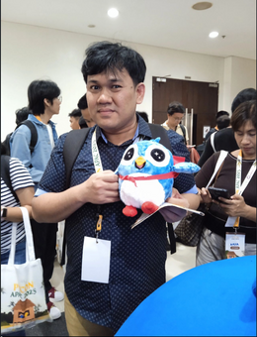



About Me
x
Applicant for:
Data Engineer
Cloud Engineer
AI / LLM Engineer (Entry-Level)
Cloud Engineer
Data Engineer
AI / LLM Engineer

Slide 3
TABLE OF CONTENT
x
Problem
Solution
Flowchart
Process
Demo
Conclusion
References

Slide 4

Statement of the Problem
x
Context: Spelling proficiency is a cornerstone of literacy, directly impacting a student's ability to read, write, and communicate effectively. For elementary students (Grades 1-6), mastering foundational spelling skills is critical for future academic success. In a preliminary diagnostic assessment conducted by a Senior High School teacher, a spelling test was administered to a group of senior high school students to evaluate their current competency levels.
The Core Problem: A teacher gave a spelling test to some senior high school students and discovered a big problem: a lot of them failed. Their mistakes showed they were missing some basic spelling rules they should have learned back in elementary school. This suggests there's a major gap in their education that needs to be fixed.

Slide 5
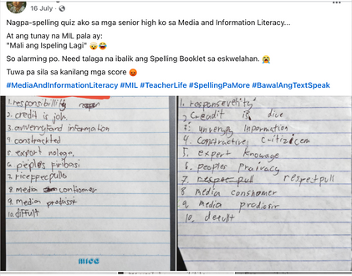
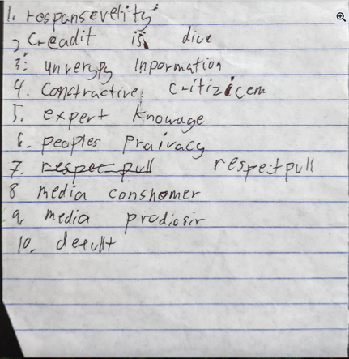
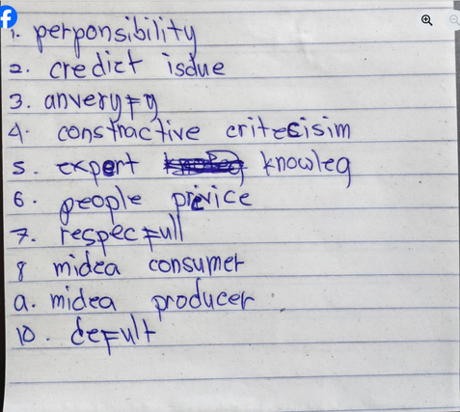
Statement of the Problem
x
Notes 1
Notes 2
Notes 3

Slide 6

Solutions:
x
I implemented a Speech-to-Speech Agent-to-Agent approach using Gemini 2.0 Flash to deliver an interactive spelling quiz where learners listen to words and spell them aloud. The system also generates comprehensive improvement reports and action plans to enhance both spelling accuracy and listening skills.
To solve the "one-size-fits-all" problem, the app's "Spelling Master Agent" acts as a personal AI tutor that analyzes student performance in real-time. It then uses an adaptive algorithm to automatically adjust the word difficulty, ensuring each child follows a personalized learning path that keeps them perfectly challenged and engaged.
This application solves key educational challenges by offering a personalized learning path where an AI agent adapts word difficulty based on student performance. It simultaneously boosts motivation by turning spelling practice into an engaging, game-like conversation with rewards and positive audio feedback.

Slide 7
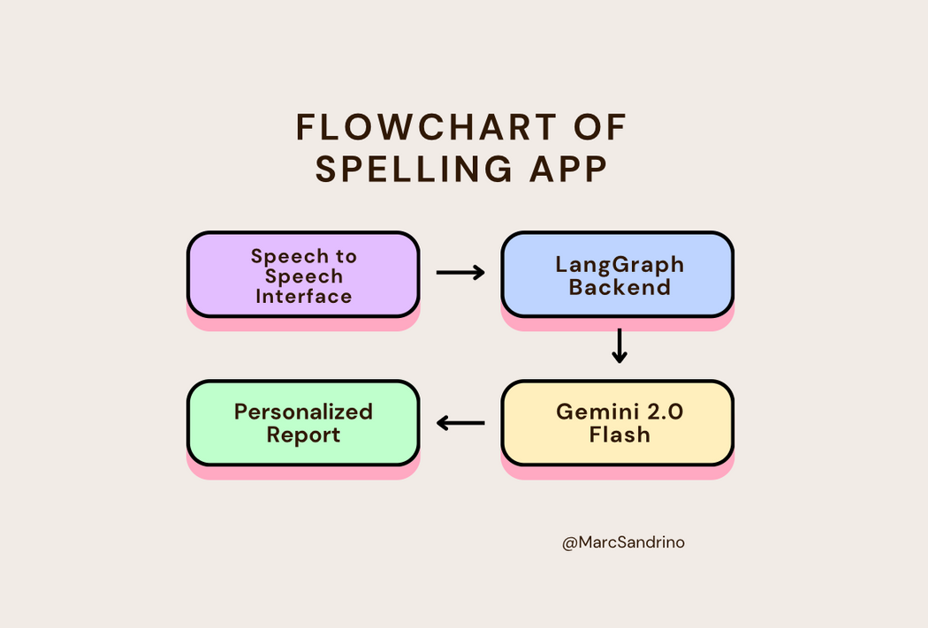
Flowchart
x

Slide 8
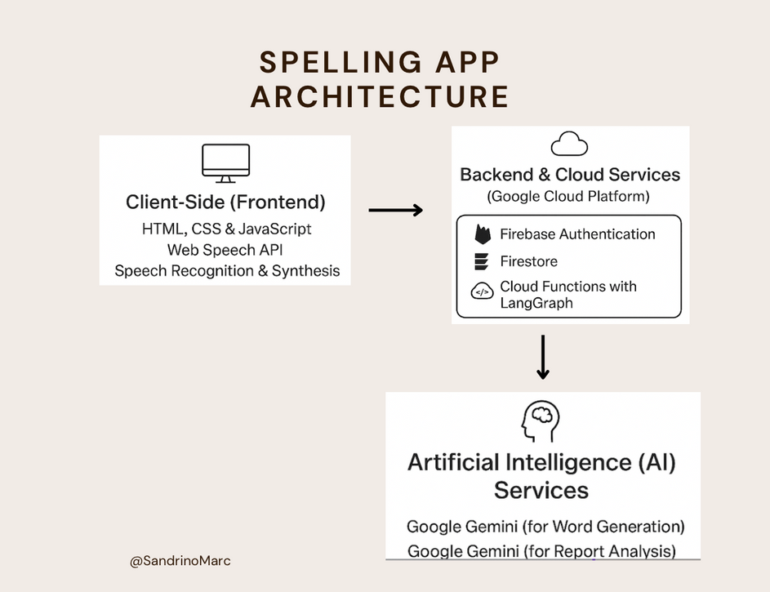
Architecture of the Spelling App
x

Slide 9
PROCESS
x
1
2
3
Upon launching the app, the user enters their name and selects a grade, triggering a secure, anonymous authentication process in the background. Once the quiz is started, the app makes a live API call to a Google Gemini model to generate a unique list of age-appropriate spelling words. This ensures every quiz is a fresh and tailored experience from the very beginning.
For each word in the quiz, the app first speaks the word aloud and then listens for the user to spell it back within a 15-second time limit. The system instantly converts the user's voice into text, compares it to the correct spelling, and provides immediate audio-visual feedback. This interactive loop of hearing, speaking, and evaluating repeats for all ten words.
Once the quiz is finished, the app compiles the user's score and incorrect words, sending them to a secure backend Cloud Function for analysis. There, a powerful Gemini AI model generates a personalized improvement report based on the specific mistakes made. This complete quiz summary and AI-generated report are then saved permanently to the database and displayed on the user's results screen.

Slide 10
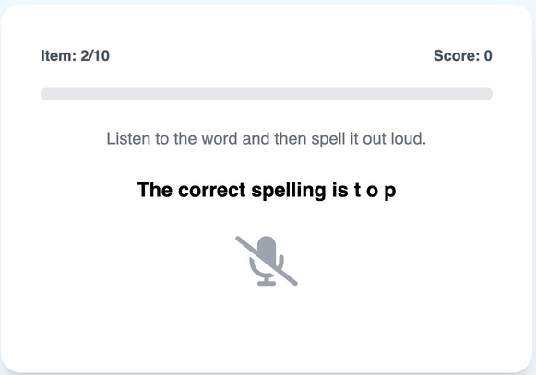
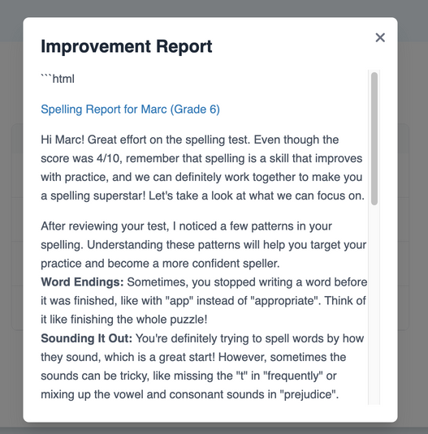
DEMONSTRATION
x
Speech to Speech
Improvement Report

Slide 11
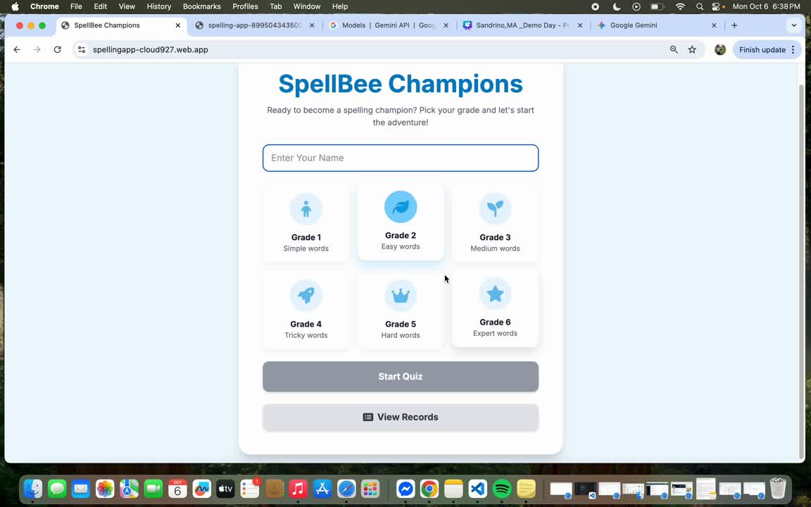
DEMONSTRATION
x

Slide 12
CONCLUSION
x
This spelling application serves as a foundational proof-of-concept designed for future research. The long-term vision is to expand it into a comprehensive pedagogical tool with features like video analysis of learners, in-school pilot testing, a teacher dashboard, and a robust framework for tracking reliability and performance metrics. Development of the current prototype was navigated within the constraints of a free-tier Gemini API and limited funding.
These limitations prompted a strategic pivot towards an alternative study with senior high school students to validate the core AI "Agent-to-Agent" model, ensuring the research could progress. Ultimately, it is my primary academic goal to pursue the full development of this project upon acceptance into a Master of Science in Computer Science program.

Slide 13
References:
x
AI in education:
Baker, R. S. (2016). Stupid Tutoring Systems, Intelligent Humans. International Journal of Artificial Intelligence in Education, 26(2), 600–614. https://doi.org/10.1007/s40593-016-0105-z
Cloud Platform & Serverless Architecture:
Google. (2025). Firebase Documentation. Retrieved October 3, 2025, from https://firebase.google.com/docs
Agent-to-Agent Approach:
Wooldridge, M. (2009). An Introduction to MultiAgent Systems (2nd ed.). John Wiley & Sons.
Artificial Intelligence Models & APIs
Google. (2025). Gemini API Documentation. Retrieved October 3, 2025, from https://ai.google.dev/docs/gemini_api_overview
Core Web Technologies:
Mozilla Developer Network. (2025). Web Speech API. Retrieved October 3, 2025, from https://developer.mozilla.org/en-US/docs/Web/API/Web_Speech_API

Slide 14
THANK YOU
Follow me on LinkedIN: Marc Sandrino

